Slide 1
Internet Safety for Parents
A practical guide

Slide 2
Part 1: Mobile device safety
How can I protect my children – Technologies available
Tablets & Mobiles
Android Devices
Apple Devices (Eddie Dowse)

Slide 3
What technologies are available to protect my kids?
                Modems
                Routers
                Firewalls
                Access Points
                Web Filters
                Mobile Device Managers

Slide 4
Hardware
Modems
Routers
Firewalls
Access Points
3rd Party devices like iKydz

Slide 5
Modems
What is a modem?
  The most basic of devices, this connects you to your internet provider’s network.
What do I need to enable this?
  Normally supplied by the ISP, you don’t need any more.
What are the disadvantages?
  No real setup is required, but this provides nothing to you in terms of internet safety.
  This is only a tool to allow a connection to the ISP.
  Normally built into a router.

Slide 6
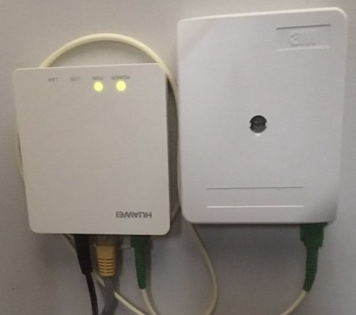
Example: Fiber to the Home (FTTH) Modem

Slide 7
Router
What is a Router?
  A Router is a device which allows your personal devices to access the internet.
What do I need to enable this?
  Normally supplied by the ISP, you don’t need any more.
What are the disadvantages?
  These are typically multipurpose, a modem, a router, an access point and a firewall built into one single device.
  Performs adequately for the above purposes if you have no further safety requirements.
  Not very customizable.
  Typically does not have a wide range of features like content filtering available.

Slide 8
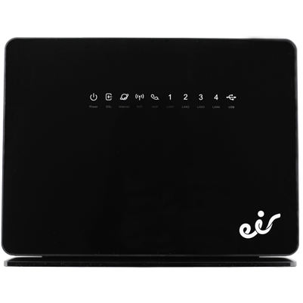
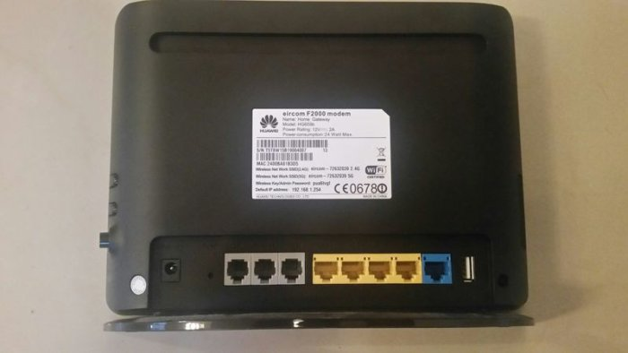
Example eir Router

Slide 9
Firewalls
What is a firewall?
  A firewall prevents access from the internet to your devices, but allows your devices access the internet safely.
What do I need to enable this?
  A 3rd party device which runs firewall software.
    Some free examples are Sophos XG, PfSense or OPNSense.
    These can be loaded onto old PC’s with multiple wired network cards (e.g. one WAN, one LAN)
What are the disadvantages?
  Difficult to setup for novice users (not plug and play)
  Requires changes to your ISP router in order to work (router becomes a simple modem)
  Also require additional hardware
    Firewall Server hardware
    Wireless Access points

Slide 10
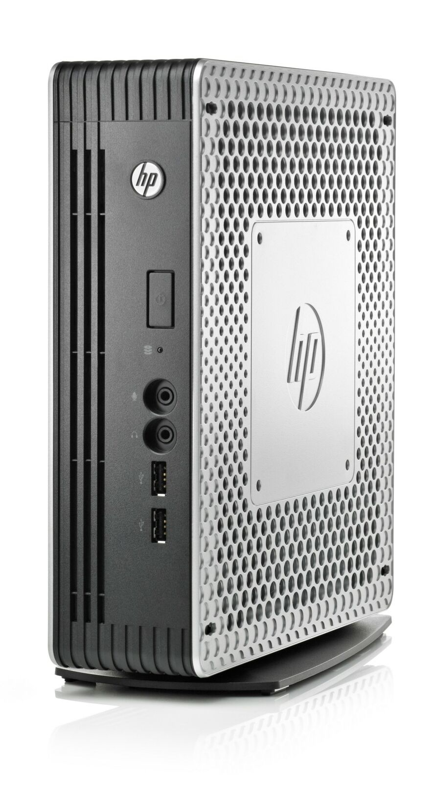
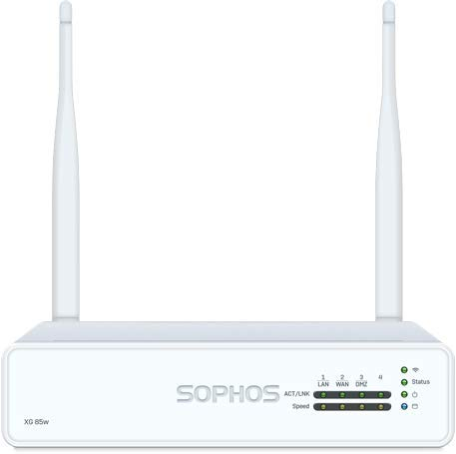
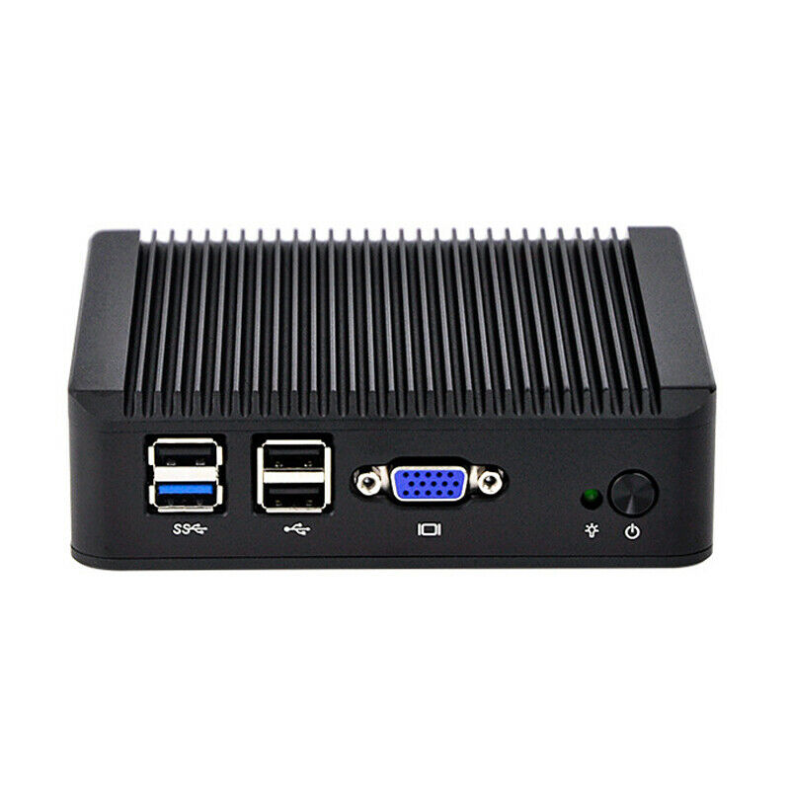
Examples of Factory and Home-brew Firewalls

Slide 11
Access Points
What is an Access Point?
  Simply put, a device that provides internet access without network cables to your laptop or tablet.
What do I need to enable this?
  A 3rd party access point.
    TPLink, Linksys, Netgear etc
What are the disadvantages?
  Extra devices plugged in (Messy cables etc)
  Requires separate configuration from Firewall

Slide 12
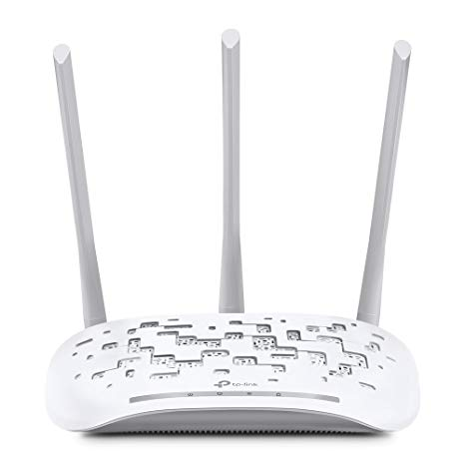

Examples of Wireless Access Points

Slide 13
3rd Party Hardware example ‘iKydz’
What is iKydz?
  An additional access point/router that plugs into your network
  Children connect to this device instead of your home wireless
  Enables parents to perform content filtering, screen-time and real time protection.
What do I need to enable this?
  iKydz device (Pro or Home)
What are the disadvantages?
  Costly devices (Pro - €139, Home - €99)
  Device coverage in larger homes may be weak.

Slide 14
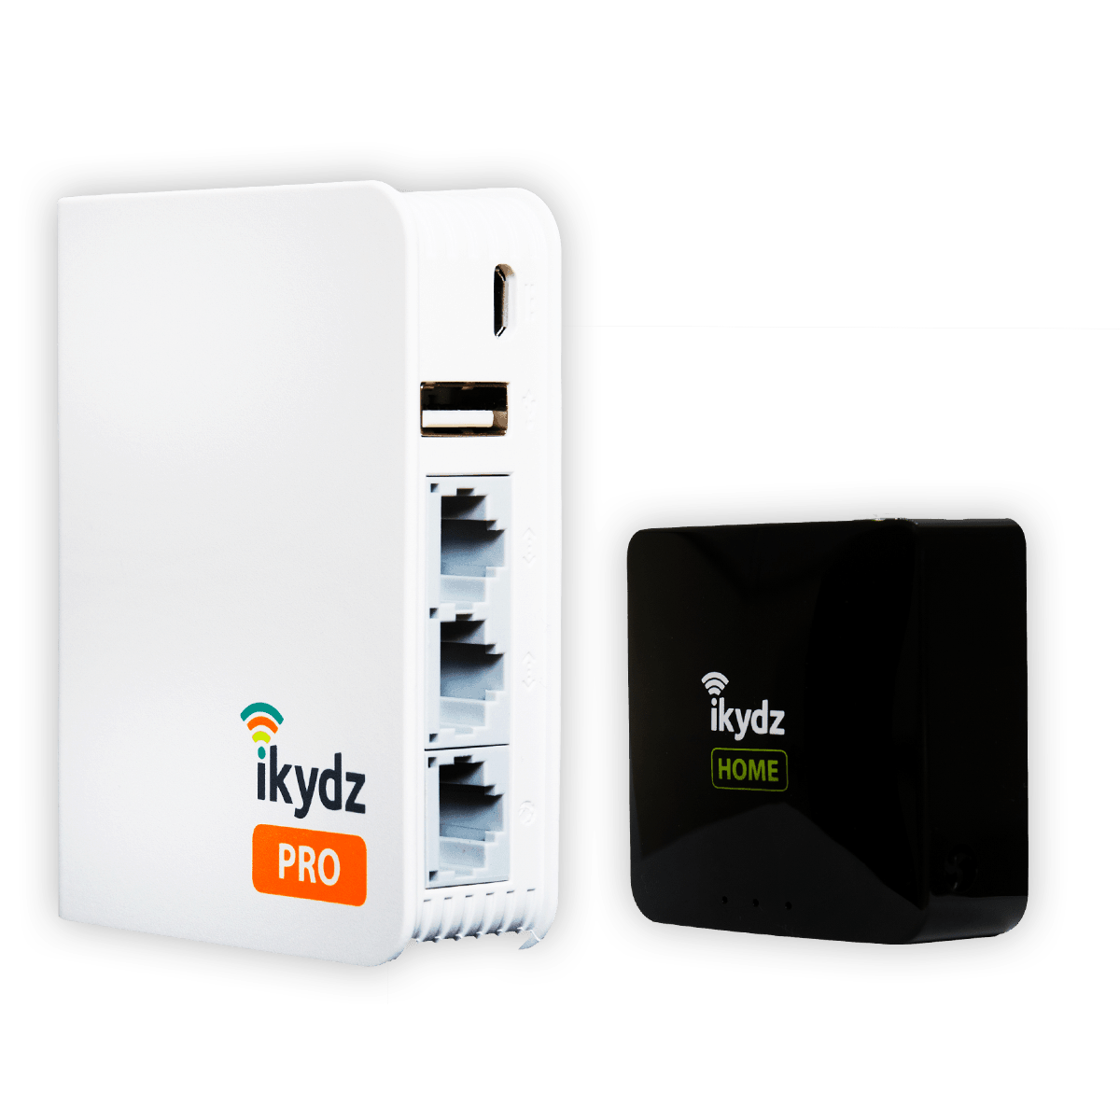
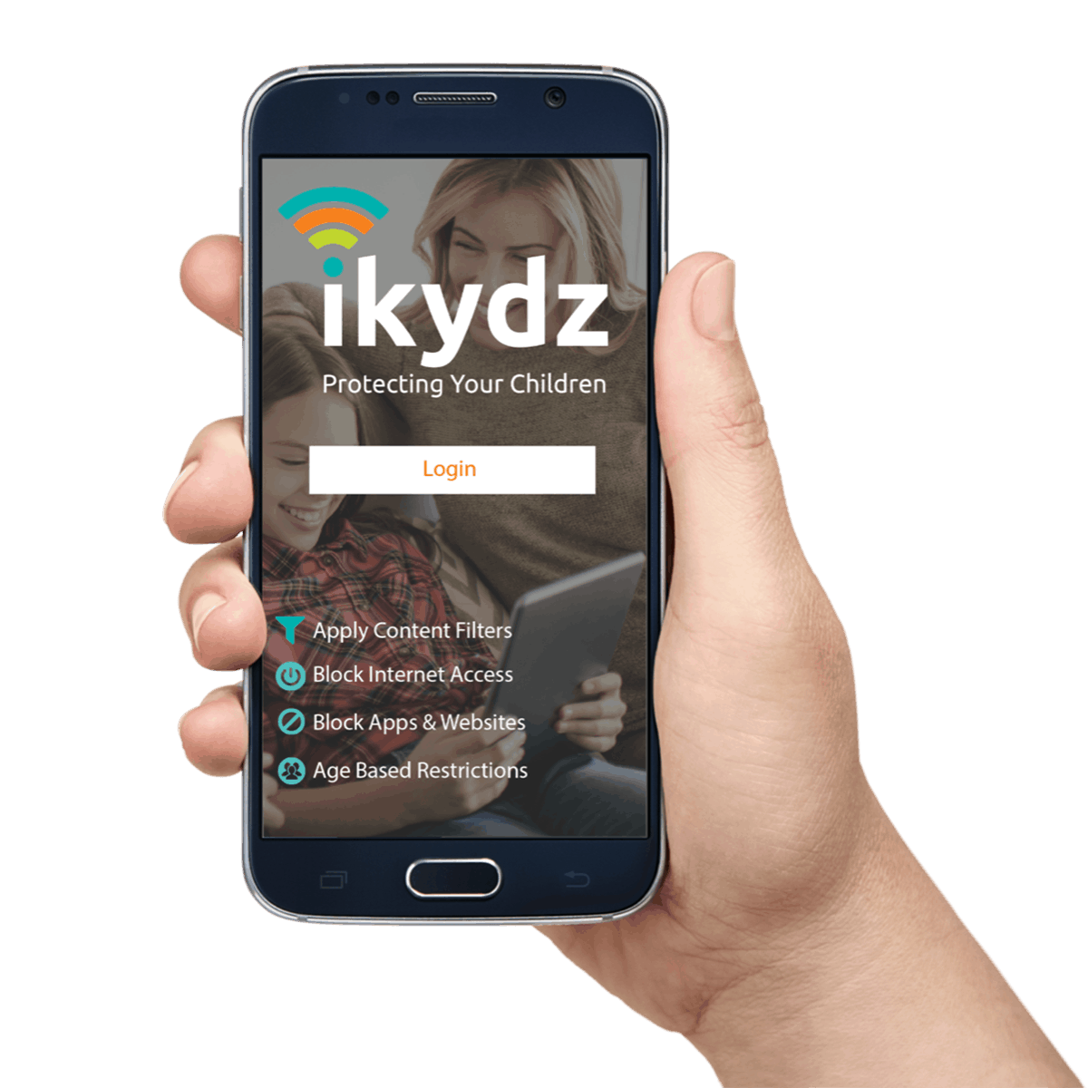
Examples of 3rd Party Devices

Slide 15
Software
Modems
Routers
Firewalls
Access Points
3rd Party devices like iKydz

Slide 16
Web Filtering
What is Web Filtering?
  A system to filter out the bad things found on the internet
    Adult websites
    Social Networks
    Terrorism linked
    Hacking
    Drugs misuse etc…
What do I need to enable this?
  An advanced home firewall like Sophos XG (Free) or similar.
What are the disadvantages?
  Difficult to setup for novice users (not plug and play)
  Requires changes to your ISP router in order to work (router becomes a simple modem)
  Also require additional hardware
    Firewall Server hardware
    Wireless Access points

